Slide 1
(Th)Rust in Space: Initial Momentum
May, 7th, 2024

Slide 2
Export Control Information
Section 1 (not applicable in France, please go to section 3)
This document contains Technical Information : Yes No
If No to section1: please complete Section 2
If Yes to section1: please complete Section 3 as applicable
Section 2 (not applicable in France, please go to section 3)
I confirm the document does not contain Technical Information and is « Not-Technical »
Name:
Date:
Section 3
3a. National and EU regulations Export Control Assessment
This document has been assessed against applicable export control regulations in
France Germany Spain UK Other: [Specify the country]
and does not contains Controlled Technology¹ and is therefore « Not Listed / Not Controlled »
and contains Controlled Technology with export control classification [Insert classification number, e.g ML22x, xExxx, AMAx]
Note: Any transfer of this document in part or in whole must be made in accordance with the appropriate export control regulations. Prior to any transfer outside of the responsible legal entity, confirmation of an applicable export licence or authorisation must be obtained from the local Export Control Officer (ECO).
3b. US (ITAR/EAR) Export Control Assessment
This document does not contains US origin Technical Data (Technology)
This document contains « Technology » which is controlled by the U.S government under [USML category number / ECCN] and which has been received by [Legal entity] under the authority of [Licence number / ITAR exemption / EAR licence exception / NLR]
This document contains technology which is designated as EAR99 (subject to EAR and not listed on the USML/CCL.)
Note: Any re-export or re-transfer of this document in part or in whole must be made in accordance with the appropriate regulation (ITAR or EAR) and applicable authorization. If in any doubt please contact your local ECO.
3c. Technical Rater Information
This document has been assessed by the following Technical Rater :
Assessed and classified by:
Date classification completed:
¹ “Controlled Technology” is defined as any Information necessary for the design, development, production, use, operation, maintenance or repair of export controlled goods. Examples of such Information are blueprints, plans, diagrams, models, engineering designs, manuals, requirements specifications and instructions etc. If in any doubt please contact your local Export Control Officer (ECO)
© AIRBUS SAS 2024. ALL RIGHTS RESERVED.

Slide 3


About Me
Michaël Melchiore
Digital Payload On-Board SW Specialist
Airbus Defense & Space @Toulouse, France
michael.melchiore@airbus.com
Data-intensive real-time SW for more than 15 years
Focus on lower layers (middleware, framework)
Worked in various industries (Railway, Radar and Space)
Your team (reluctant) “Multicore Artist”
Discovered Rust in 2014, tried to bring it to work ever since…
Succeeded in 2022 (!)

Slide 4
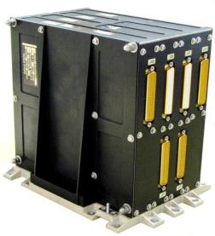
Satellite Design Constraints
Space is an hostile operating environment
Radiations, cosmic particles
Electromagnetic fields
Temperature gradients
Space is expensive to reach
Size, Weight and Power (SWaP)
Small, light and energy efficient
Specialized technologies are required, which started very small
Small memories (a few KB)
Very slow processors (20x slower)
Slow communication links (a few Kb/s)

Slide 5
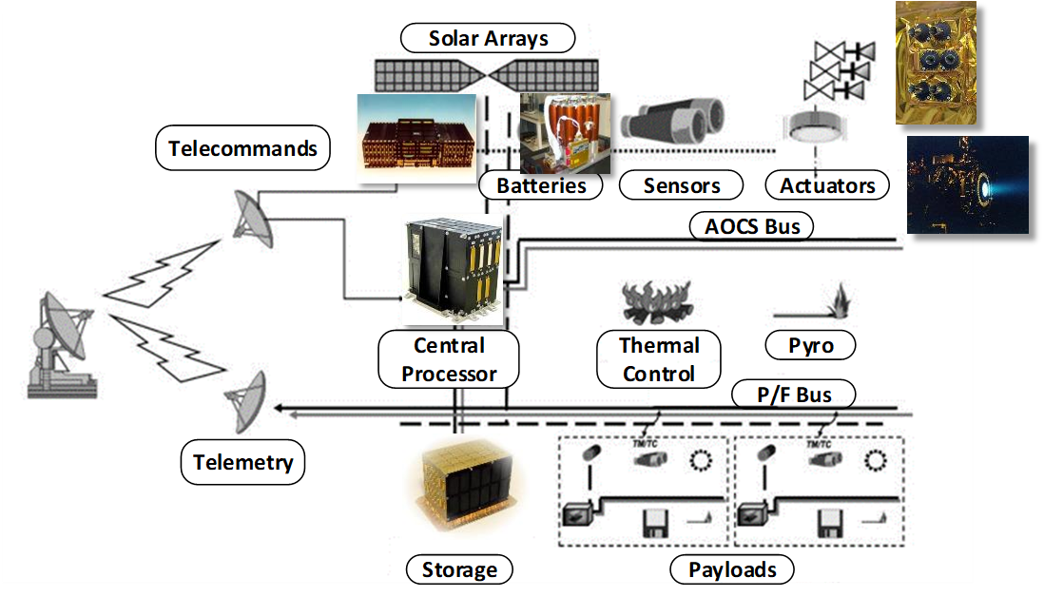
Role of the On-Board SW
Control, regulate, monitor
Power/Temperature
Orientation/Orbit
Manage the mission
Manage equipment
Take pictures (for example) & store data
Downlink data to ground stations
Interact with operators
Execute commands
Provide reports

Slide 6


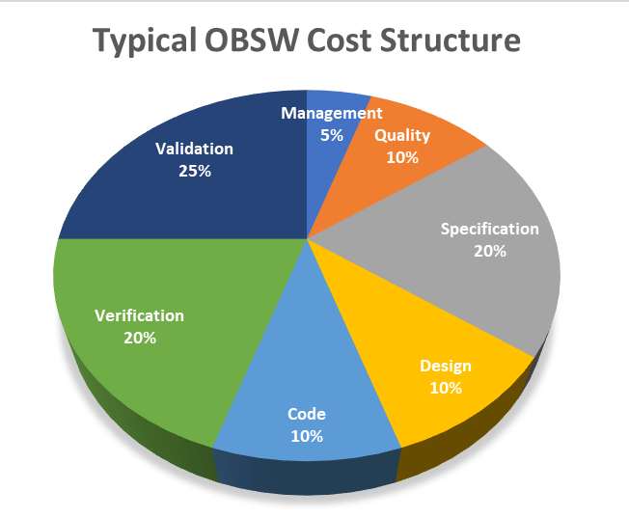
On-Board SW Stakes
Real-time embedded SW developed in C
Critical functions are executed cyclically (thermal@0.1Hz, attitude@10Hz)
Always meet deadlines in every situation
Fit into limited execution resources (memory, processing)
Control of specialized/complex HW
Satisfy operating modes in every case, across all possible configurations
Flexible configuration to adapt to failures during lifetime
Outstanding Non Func./Quality constraints to be met
Strong reliance on manual code reviews
Recurring, cost & time investment (3x feature impl. cost)
How to scale our workflow to tackle modern challenges?
ECSS | European Cooperation for Space Standardization
MISRA | Motor Industry Software Reliability Association

Slide 7
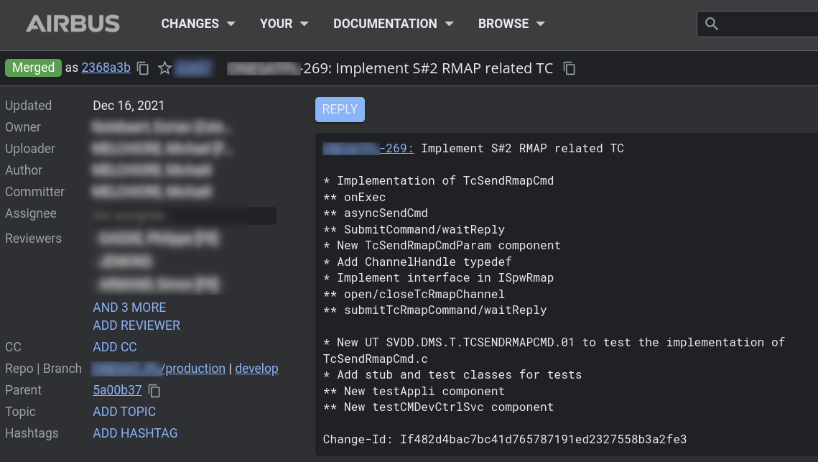


(Th)Rusting Forward
Study “Using game engine techniques and Rust to modernize On Board software” (OXYDE)
ESA Contract No.140066/22/NL/GLC/ov
Port telecom payload to Rust, using ECS design principle
Methodology
Build factual evidence of potential migration trade-offs
Leverage existing code review database
Focus on business-specific functions, instead of rewriting everything from scratch, in Rust

Slide 8
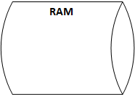

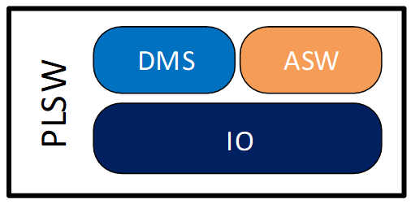
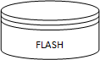
SW Mitigation of HW Resets
Minimize impact of SW/HW resets on mission
Identify vital execution context for critical business functions (≈500 MB)
Periodically snapshot context into reliable storage
Automatically restore latest archive at reboot
Key non-functional requirements
Prevent data corruption due to concurrent context updates during backups
Minimize Flash device power on cycles to maximize device lifetime
Verification requires continuous, extensive testing and peer reviews
ASW | Application SoftWare
DMS | Data Management System
PLSW | PayLoad SoftWare

Slide 9
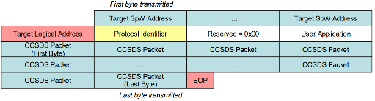
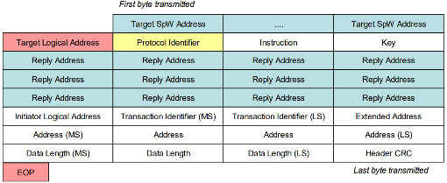
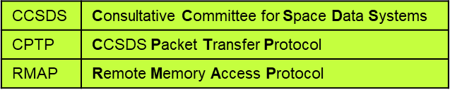
Wrapping a SpaceWire C library
SpaceWire standards
Spacecraft Communication Network (ECSS-E-ST-50-12C)
Family of associated protocols (ECSS-E-ST-50-[51/52/53]C)
Non-trivial, dynamic packet structure
C library exposing a single, public opaque frame type
Promote zero-copy design, ease error management
Manage metadata associated with buffer content
Field offsets, derived attributes
Expose getter/setters to read or write frame content
CPTP
RMAP Read Command

Slide 10
Rust Binding V1
Raw *_sys bindings (automatically) generated with bindgen
Safe Rust binding to tackle code review feedbacks
(Truly) encapsulate C struct internals
Mandatory, ergonomic error checking
Enforced frame lifecycle with Builder pattern
spwapi/src/lib.rs
use spwapi_sys::*;
pub struct FrameBuilder<'a> {
pub(crate) _buffer: Buffer<'a>,
pub(crate) frame: spw_frame,
}
impl<'a> FrameBuilder<'a> {
pub fn with_buffer(mut buffer: Vec<u8>) -> Self {}
pub fn with_slice(slice: &'a mut [u8]) -> Self {}
// Internal buffer access
pub fn buffer(&self) -> &[u8] {}
pub fn buffer_mut(&mut self) -> &mut [u8] {}
// Parse buffer content to compute metatadata
pub fn parse(self, size: u32) -> Result<Frame, …> {}
}
pub struct Frame(pub(crate) FrameBuilder);
impl Frame { pub fn cargo(&self) -> Option<&[u8]>
pub fn cargo_mut(&mut self) -> Option<&mut [u8]> }
spwapi.h
// Provide storage for frame data
void frame_init(struct spw_frame * self,
uint8_t * buffer,
uint32_t buffer_size)
// Access internal buffer
uint8_t* frame_buffer(struct spw_frame const * self);
// Compute frame metadata
int frame_parse(struct spw_frame * frame, uint32_t size);
// Getters / setters
uint8_t * frame_cargo(struct spw_frame const * self,
uint32_t * cargo_length,
uint8_t ** crc);

Slide 11
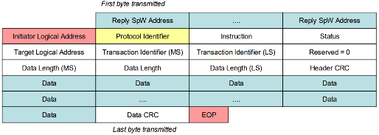
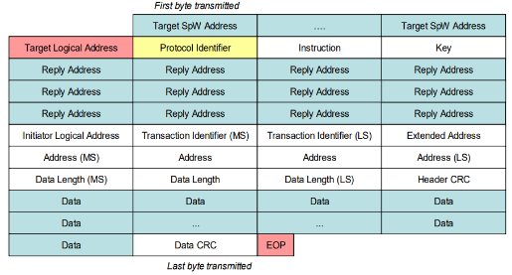
Preventing Frame Corruptions
A function can simultaneously handle hundreds of frames, up to 4 KB each
Incrementally prepare a RMAP Write Command based on previous RMAP Read Reply cargo
Share the buffer across related frames
RMAP Read Reply
RMAP Write Command

Slide 12

Preventing Frame Corruptions
A function can simultaneously handle hundreds of frames, up to 4 KB each
Incrementally prepare a RMAP Write Command based on previous RMAP Read Reply cargo
Share the buffer across related frames
RMAP Read Reply
RMAP Write Command

Slide 13
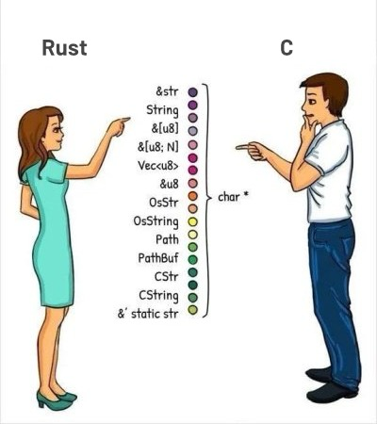
Fearless Optimization with Rust
In Rust, owned and shared buffers are different types…
… so we can build different API to handle the consequences
Help users AND developers
pub(crate) enum Buffer<'a> {
Slice(&'a mut [u8]),
Vec(Vec<u8>),
}
pub struct FrameBuilder<'a> {
pub(crate) _buffer: Buffer<'a>,
/* … skipped … */
}
impl<'a> FrameBuilder<'a> {
pub fn with_buffer(mut buffer: Vec<u8>) -> Self {}
pub fn with_slice(slice: &'a mut [u8]) -> Self {}
}
pub struct Frame(pub(crate) FrameBuilder);
impl Frame {
pub fn cargo(&self) -> Option<&[u8]> -> {}
pub fn cargo_mut(&mut self) -> Option<&mut [u8]> -> {}
// Get back the builder to process another frame
pub fn reuse(mut self) -> FrameBuilder<'a> {} }

Slide 14
Smart Flash Power Management (1/5)
pub struct FlashSession;
Step by step guide of the design process
Define an active Flash session type

Slide 15
Smart Flash Power Management (2/5)
pub struct FlashSession;
impl FlashSession {
pub fn send(&mut self, …)-> Result<…> {}
pub fn receive(&mut self, …) -> Result<…> {}
}
Step by step guide of the design process
Define an active Flash session type
Restrict Flash accesses to active Sessions only

Slide 16
Smart Flash Power Management (3/5)
pub struct FlashSession;
impl FlashSession {
pub fn send(&mut self, …)-> Result<…> {}
pub fn receive(&mut self, …) -> Result<…> {}
}
Step by step guide of the design process
Define an active Flash session type
Restrict Flash accesses to active Sessions only
Define a Flash endpoint type to manage device sessions
pub struct FlashEndpoint;
impl FlashEndpoint {
pub fn new_session(&mut self, …) -> Result<FlashSession, …> {}
}

Slide 17
Smart Flash Power Management (4/5)
pub struct FlashSession(Sender<FlashSessionEvent>);
impl FlashSession {
pub fn send(&mut self, …)-> Result<…> {}
pub fn receive(&mut self, …) -> Result<…> {}
}
Step by step guide of the design process
Define an active Flash session type
Restrict Flash accesses to active Sessions only
Define a Flash endpoint type to manage device sessions
Encode session lifecycle events in type systems
pub struct FlashEndpoint {
sender: Sender<FlashSessionEvent>,
}
impl FlashEndpoint {
pub fn new_session(&mut self, …) -> Result<FlashSession, …> {
/* … skipped … */
self.sender.send(FlashSessionEvent::Created);
/* … skipped … */
}
}
pub enum FlashSessionEvent { Created, Finished }
impl Drop for FlashSession {
fn drop(&mut self) {
self.0.send(FlashSessionEvent::Finished);
}

Slide 18
Smart Flash Power Management (5/5)
pub struct FlashSession(Sender<FlashSessionEvent>);
impl FlashSession {
pub fn send(&mut self, …)-> Result<…> {}
pub fn receive(&mut self, …) -> Result<…> {}
}
Step by step guide of the design process
Define an active Flash session type
Restrict Flash accesses to active Sessions only
Define a Flash endpoint type to manage device sessions
Encode session lifecycle events in type systems
Process lifecycle events in a cyclic function to control power
pub struct FlashEndpoint {
sender: Sender<FlashSessionEvent>,
receiver: Receiver<FlashSessionEvent>,
}
impl FlashEndpoint {
pub fn new_session(&mut self, …) -> Result<FlashSession, …> {
/* … skipped … */
self.sender.send(FlashSessionEvent::Created);
/* … skipped … */
}
}
pub enum FlashSessionEvent { Created, Finished }
impl Drop for FlashSession {
fn drop(&mut self) {
self.0.send(FlashSessionEvent::Finished);
}
pub fn control_flash_power(endpoint: &mut FlashEndpoint) {}

Slide 19
Exclusive Execution Context Access
#[derive(Resource)]
pub struct WorkingArea(Option<Data>);
pub struct ArchiveSession {
data: Option<Data>,
/* ... skipped ... */
}
#[derive(Resource)]
pub struct ArchiveManager{
/* ... skipped ... */
}
impl ArchiveManager {
pub new_session(&mut self, area: &mut WorkingArea)
-> Option<AreaSession> {
let data = area.data.take()?;
/* ... skipped ... */
}
}
pub struct AreaAvailable(Data);
impl Drop for ArchiveSession {
fn drop(&mut self) {
let data = self
.data
.take()
.expect(“Active session data is always Some");
self.sender.send(AreaAvailable(data));
}
}
pub fn unlock_working_area(
mng: Res<ArchiveManager>,
mut area: ResMut<WorkingArea>) {
if let Ok(evt) = mng.0.try_recv() {
area.data = Some(evt.0);
}
}
Key takeaways
Simple concepts compounds to solve traditionally complex issues
Requirement verification burden transferred to the compiler!

Slide 20
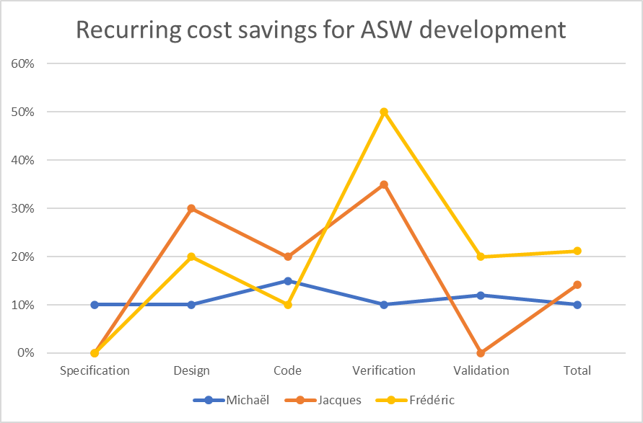


Conclusions
Rust provides a promising framework for modern OBSW development
Excellent tooled-up ecosystem focused on code quality and productivity
Demonstrated ability to leverage existing C assets
Expressive & flexible type system with unique semantics…
…leveraged by everyone to build efficient & reliable SW
Upcoming activities
Re-visit constellation customer feature requests
Complete performance baseline
Currently identified enablers on which we want to collaborate
Spaceworthy OS/HW support
Ecosystem maturity growth

Slide 21
Thank you
Airbus Amber

Slide 22
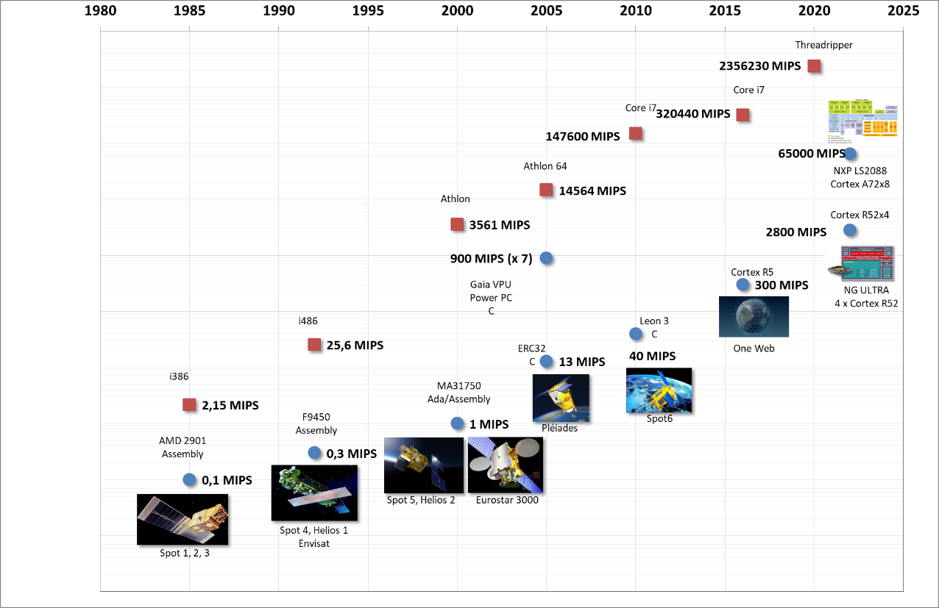
A Brief Timelapse about Satellite Processors
x 1 000 000
PAYLOAD
PC
PLATFORM
x 30 000

Slide 23
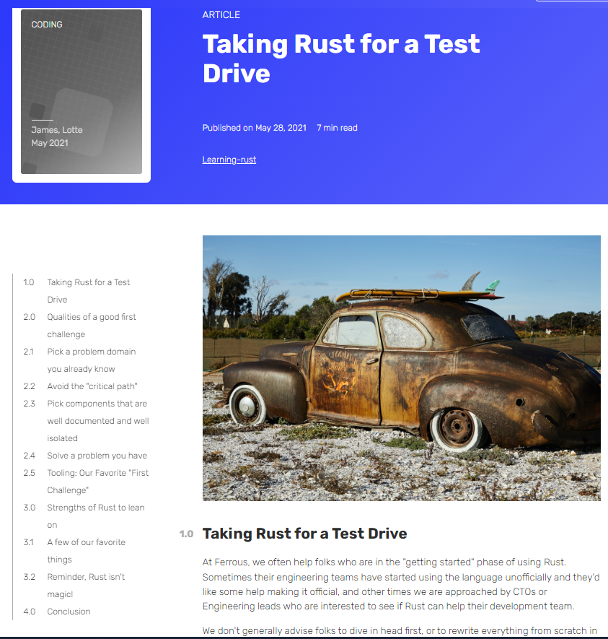
First (Baby) Steps
“Taking Rust for a Test Drive“ by Ferrous Systems
“Adopting Rust to Achieve Business Goals” by Tweede Golf
Key Insights
Start small and early
Focus on quick, concrete first results
Consider your SW larger environment (tests, tools…)
Seek professional training
Do not underestimate human factors!
Introduce Rust into your company’s landscape
Build practical experience with the language/ecosystem
Critical mass needed to start formal projects

